Slide 1
Predicting Outcomes of NFL Matchups
Louie Bafford

Slide 2
Problem Context
NFL has a huge market – 8 Billion in revenue in 2017
Top experts ~67% accurate
Predicting NFL Outcomes
Sports gambling platforms
NFL Analysts and other analysis platforms
Understanding important components of a winning team
Owners, GMs, Coaches, Talent Scouts, Agents

Slide 3
Data Collection
Online API - https://profootballapi.com/
Flexible data collection and feature engineering
Leverages domain knowledge
Aggregate statistics at a yearly level for each team
Compare statistics for each team matchup
Predict winner based upon matchup

Slide 4
Features
Data from 2011 to 2017 season
Features should cover many aspects of gameplay
Overall ~40 features were chosen (~20 for each team per matchup)
Focus on features which can influence team decisions
Feature | Value
QB Pass/Run ratio | Effectiveness of QB playstyle
Average Pass Length | Effectiveness of play call styles
Turnovers | Impact of turnovers influence risky play calling

Slide 5
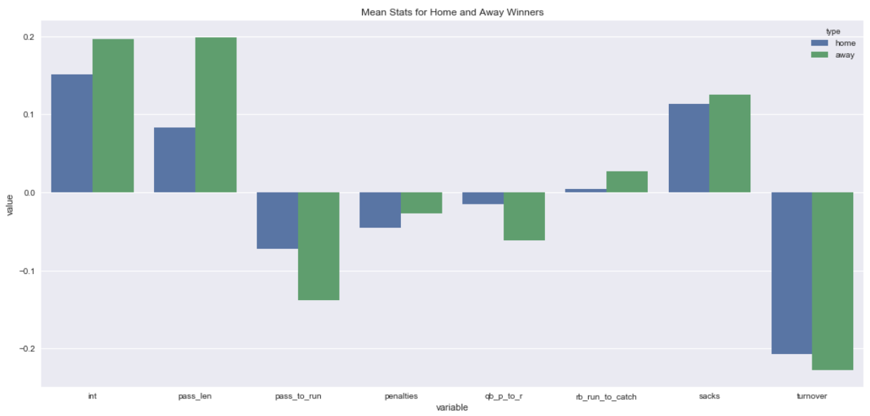
Exploratory Analysis
Average statistics of winning teams
Turnovers are most significant
Features are more extreme for away teams

Slide 6
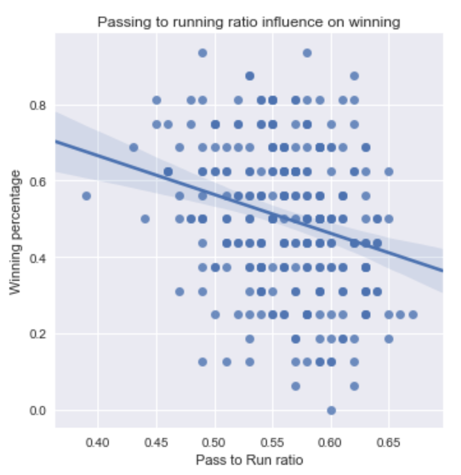
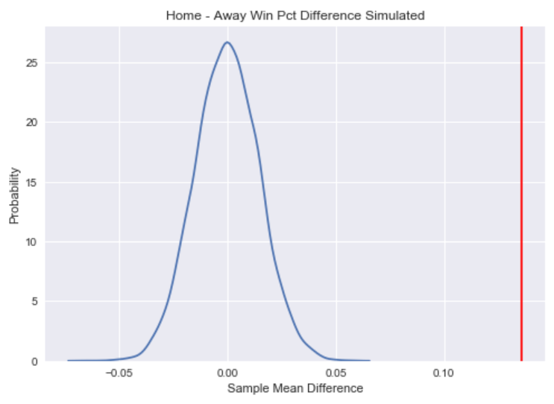
Statistical Analysis
Statistically significant correlation between low passing ratio and winning percentage
P-value < .01
Hypothesis test statistically validates home field advantage
P-value < .01

Slide 7
Building the Model
Explore and tune a list of applicable models
Linear Regression
Logistic Regression
SVM
Random Forrest
Choose top model and explore for insights

Slide 8
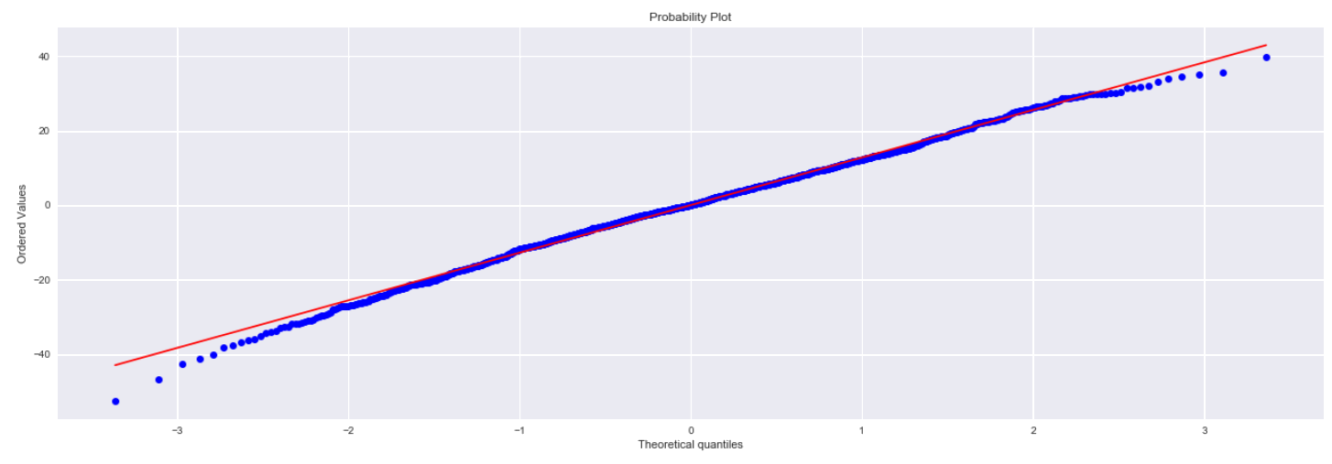
Linear Model
Train model on the score difference (an integer outcome)
Convert to binary classification to tune using accuracy as the performance metric
Training Accuracy | 69.2%
Assumption – predictions are normally distributed around correct value
QQPlot shows non-normal distribution weakening the validity of the model

Slide 9
Classification Models
Model | Training Accuracy
Logistic | 70.28%
Random Forest | 63.2%
SVM | 70.34%
Logistic Regression
Top performance among models
Feature importance visibility
Random Forest
Poor model performance
Feature importance visibility
SVM
Top performance among models
No feature visibility
Logistic Regression selected as final model
Test Accuracy: 66.36%

Slide 10
Takeaways
Improvements
Very Noisy Data
Adding features caused overfitting
Model performed best with limited features
Important Features for Model
Low Pass/Run ratio
Minimize turnovers
High Completion %
High Sack Count
Less noisy/more relevant features
Further explore feature Engineering
Hierarchical Models? – lots of correlation between features

Slide 11
Sources
Revenue
https://qz.com/1383416/amid-controversy-the-nfl-is-still-thriving-financially/
Analyst Predictions
https://www.fantasyfootballnerd.com/nfl-picks/accuracy

